Slide 1

@Annotations

Slide 2
What is annotations?
Annotations are used to provide supplemental information about a program.
Annotations start with ‘@’.
Annotations do not change the action of a compiled program.
Annotations help to associate metadata (information) to the program elements i.e. instance variables, constructors, methods, classes, etc.
Annotations are not pure comments as they can change the way a program is treated by the compiler. See below code for example.

Slide 3
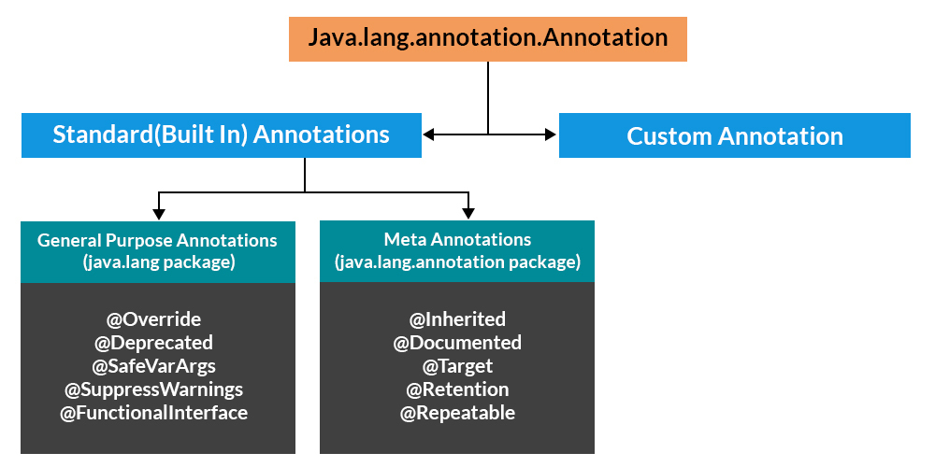
Hierarchy of Annotations in Java

Slide 4
Categories of Annotations
There are broadly 5 categories of annotations as listed:
Marker Annotations
Single value Annotations
Full Annotations
Type Annotations
Repeating Annotations

Slide 5
Category 1: Marker Annotations
The only purpose is to mark a declaration. These annotations contain no members and do not consist of any data.
Example : @TestAnnotation(),@Override.

Slide 6
Category 2: Single value Annotations
These annotations contain only one member and allow a shorthand form of specifying the value of the member.
Example: @TestAnnotations(“test”).

Slide 7
Category 3: Full Annotations
These annotations consist of multiple data members, names, values, pairs.
Example: @TestAnnotation(owner=”Rahul”, value=”Class Geeks”)

Slide 8
Category 4: Type Annotations
These annotations can be applied to any place where a type is being used. For example, we can annotate the return type of a method.
Category 5:Repeating Annotations
These are the annotations that can be applied to a single item more than once. For an annotation to be repeatable it must be annotated with the @Repeatable annotation, which is defined in the java.lang.annotation package.

